Slide 1
E-Commerce Website
E3-MiniProject.
Rgukt Rk-valley.
Team Member Details:-
1.K.SreeHari.-R171153.
2.M.Krishnaveni.-R170302.
Notes:
1

Slide 2
Table of Contents
Problem Statement
Abstract
Introduction
Modules
Results
Requirements
Conclusion
Future Enhancement
Reference

Slide 3
Problem Statement
The purpose of the E-Commerce website are to sell products to users . The primary goal of E-commerce is to reach the maximum customers at right time to increase the sales and profitability of the business. Functions of E-Commerce includes the buying and selling goods, transmitting funds or data over the internet.

Slide 4
Abstract
Electronic Commerce is process of doing business through computer networks. A person sitting on his chair in front of a computer can access all the facilities of the Internet to buy or sell the products.
Unlike traditional commerce that is carried out physically with effort of a person to go & get products, ecommerce has made it easier for human to reduce physical work and to save time.
The designed application will have an admin view and the public or guest view. The admin view is meant for the administrator to update the products, change prices, remove and add products and also manage customers. The customer view will be accessible to the customers, and they will be able to handle their information such as their name, address, and contact. Also, the customer will be able to order for products from the shop.

Slide 5
Introduction
The main objective of this project is to develop a general-purpose e-commerce store where any product (such as books, CDs, computers, mobile phones, electronic items, and home appliances) can be bought from the comfort of home through the Internet.
An online store is a virtual store on the Internet where customers can browse the catalog and select products of interest. The selected items may be collected in a shopping cart. At checkout time, the items in the shopping cart will be presented as an order. At that time, more information will be needed to complete the transaction.
So,E-commerce is fast gaining ground as an accepted and used business paradigm. More and more business houses are implementing web sites providing functionality for performing commercial transactions over the web. It is reasonable to say that the process of shopping on the web is becoming commonplace.

Slide 6
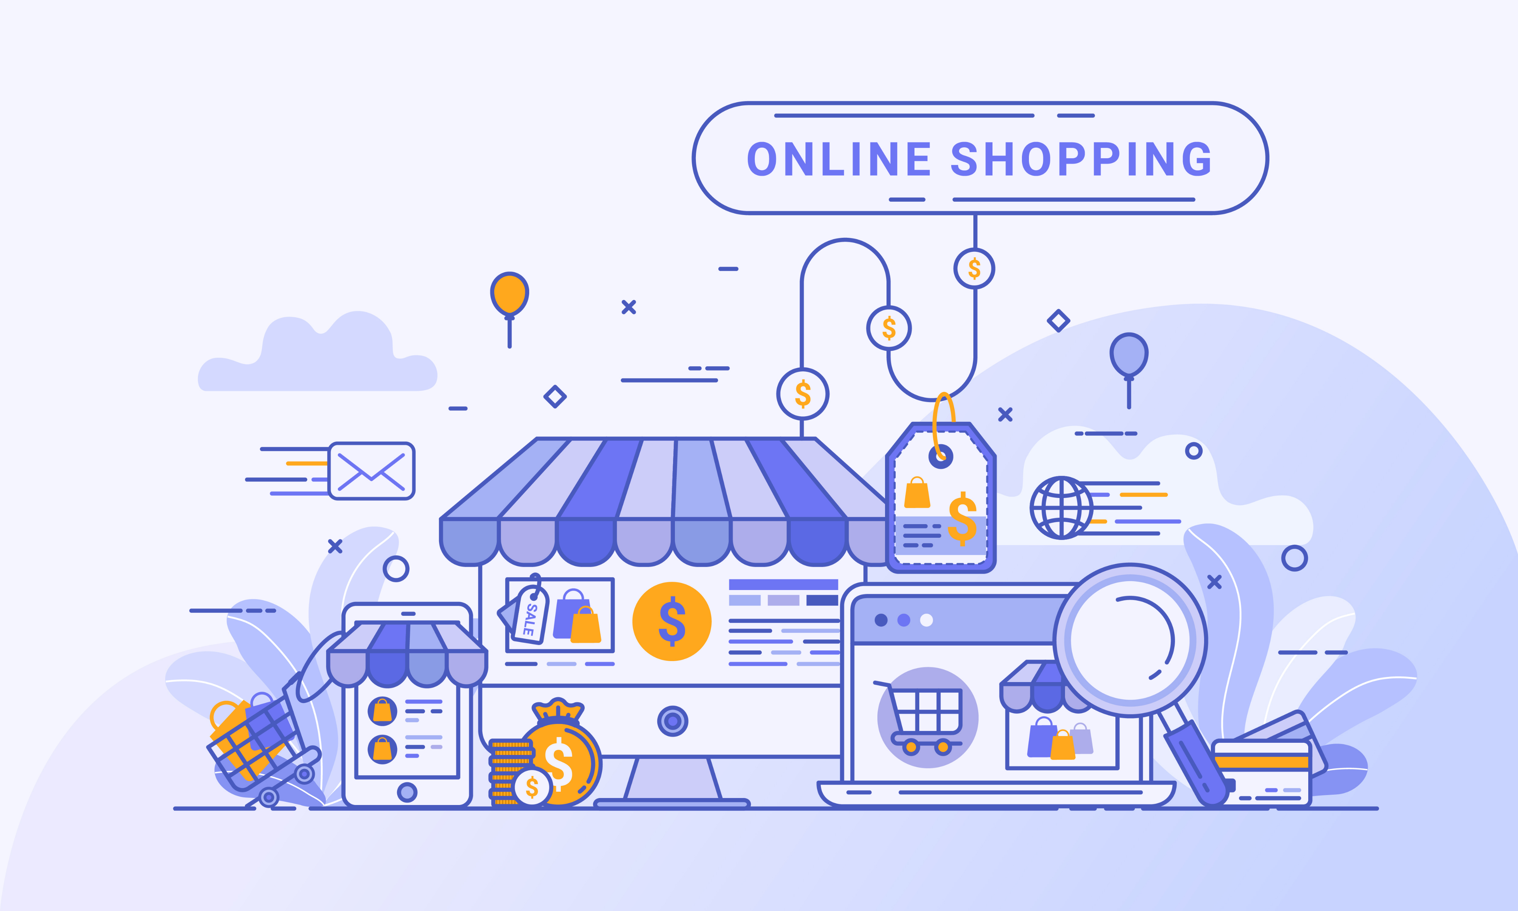
This project is mainly divided into two main categories: The Administrators and the Customers/Users.
The store manager and the staff members operate as the administrators. They can add, edit, update products or, delete products thus they able to change the names of products, change prices and, add or remove products.
The customer can search for products selection, update the cart, remove products from the cart and check out from the shop. The customer is also able to update his information such as names, address and other data.
The User is only able to browse the online shop and add a product to the cart. The user is limited to the use of the shop.

Slide 7
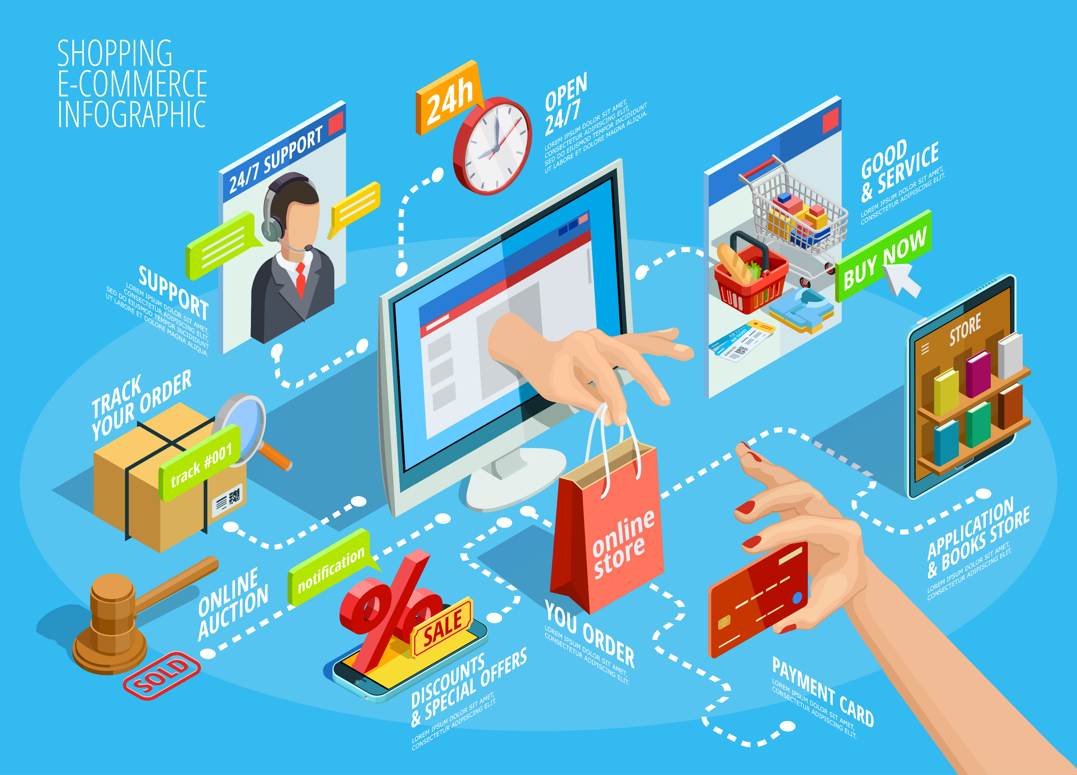

Slide 8
Modules
Homepage.
Header.
Products.
Admin.
User.
Cart.
Checkout.
Footer.

Slide 9
Homepage.
The homepage includes the basic UI structure of Website. This includes the Hot Deal Section of the E-Commerce website and Top-Selling products in website. In The home page we include slider for top selling products and we can see the products are sliding continuously in the bottom of the home page and we can Directly add this products to cart. The top selling products are based on the rating of customers and sells of a products.

Slide 10
Header.
The header contains the two nav bars and header part include the logo of shopping website and name of shopping website. We include the Names of the website owner and contact number of the owner of contacting purpose. The another navbar contains the categories of a store and the amin and user login drop down menu.
The navbar also contains the cart button function and the radio buttons to search the products in the website.

Slide 11
Products:
These Module Contains the navbar that includes the types of categories in the products(ex:-Electronics , Men’s wear , Ladies Wear , kids Wear , Home appliances , furniture and gadgets.) . This product module contains the functions of bootstrap when we click in the product it can add to cart and compare the product and we can see the ratings and we can see the prodcuct image by zoom in the picture .We can also see the radio buttons of add to Wishlist and the product and compare the products and quick view. In the bottom of every product we can see the description of product . By adding the cart we can see the drop menu of a color and size based on the product type we can see the different drop downs for the products in the store.

Slide 12
Admin.
The admin contains the login page form once we can logging into the admin module. It can contains the drop down menu with the many fields. The admin module has the access all over the website. The admin holds the users and data of a website and passwords and sensitive information of a website. The admin module can edit the user information product details and update the details in admin panel. We can view and add products , manage cart and update the cart using functionalities of admin. We can manage users and edit users in admin panel. The admin can edit like delete the customers and users and products in the website store.

Slide 13
user.
The user module contains the registration of a user. If user doesn’t have an account the user can register using register form and user has already account the user can using login form.
After logging into the user account the user can see the profile and the user can explore the products and the selected products are add into cart. After adding the products into the cart he can checkout the products by paying the bill amount and these are done at checkout process.

Slide 14
Cart.
After seeing the products in the website store the user/customer can add the products into the cart. After login of the customer only we can access the checkout the products in cart. The cart has the edit cart function that we can also delete the product when we dislike the product or for the any reason. In the cart module the price of products automatically calculates and we can increase or decrease the quantity of a products . After we can submit the checkout button in the cart.

Slide 15
Checkout.
The checkout module has the billing of the cart price. In this module we have the billing form that we can collect the billing details of the customer/user who can buys the products in the website store. After validating the all fields in the billing form the user can able to do the payment of cart amount.
The payment done in many ways in the checkout. We can include the all e-transactions in the website like visa, master, credit and debit cards. We can also include the American express business card.
Here we have one form for the payment. We can correctly enter the these fields and we encrypt these data and stores safely. After giving all the card details for payment we can check the billing amount and number of products and we can submit the continue to checkout.

Slide 16
Footer.
The Footer Module contains the bottom fields of the website. It includes the Team members details who developed the website and contact details. This footer contains About section in this we give further contact details for any help regarding the website.
In this module we include the offer-mail section that can have a field that we can enter the mail and subscribe for updates. It displays the alert after the validation of a button functionalities and it shows thanks for subscribing! For first time when ever you have subscribe and already subscribed when ever you have give the second time details. In the end we can add the our social media account information that the customers/users who can visit the website store they can contact us through these social accounts in future.

Slide 17
User flow chart:-
start
Is the user new?
no
Login to an account
yes
Register an account
Add products to cart
Checkout
logout
stop

Slide 18
Admin flowchart:-
start
Open admin panel
Input name Type,
Price,quantity
Are all inputs valid?
no
Error
message
yes
Modification of products
Mention stock
Save and update
Update product daabase
stop

Slide 19
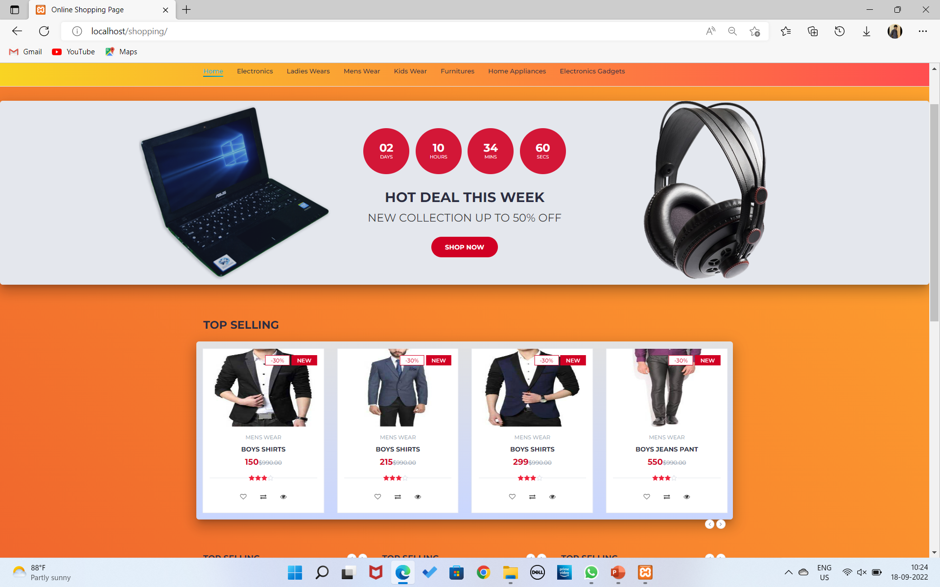
Results Homepage:-
Home page:-

Slide 20
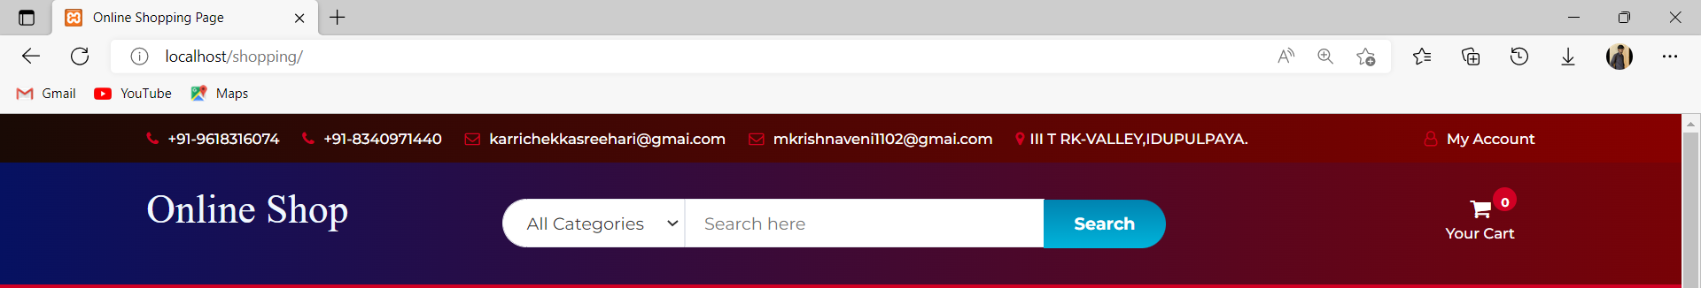
Header:-

Slide 21
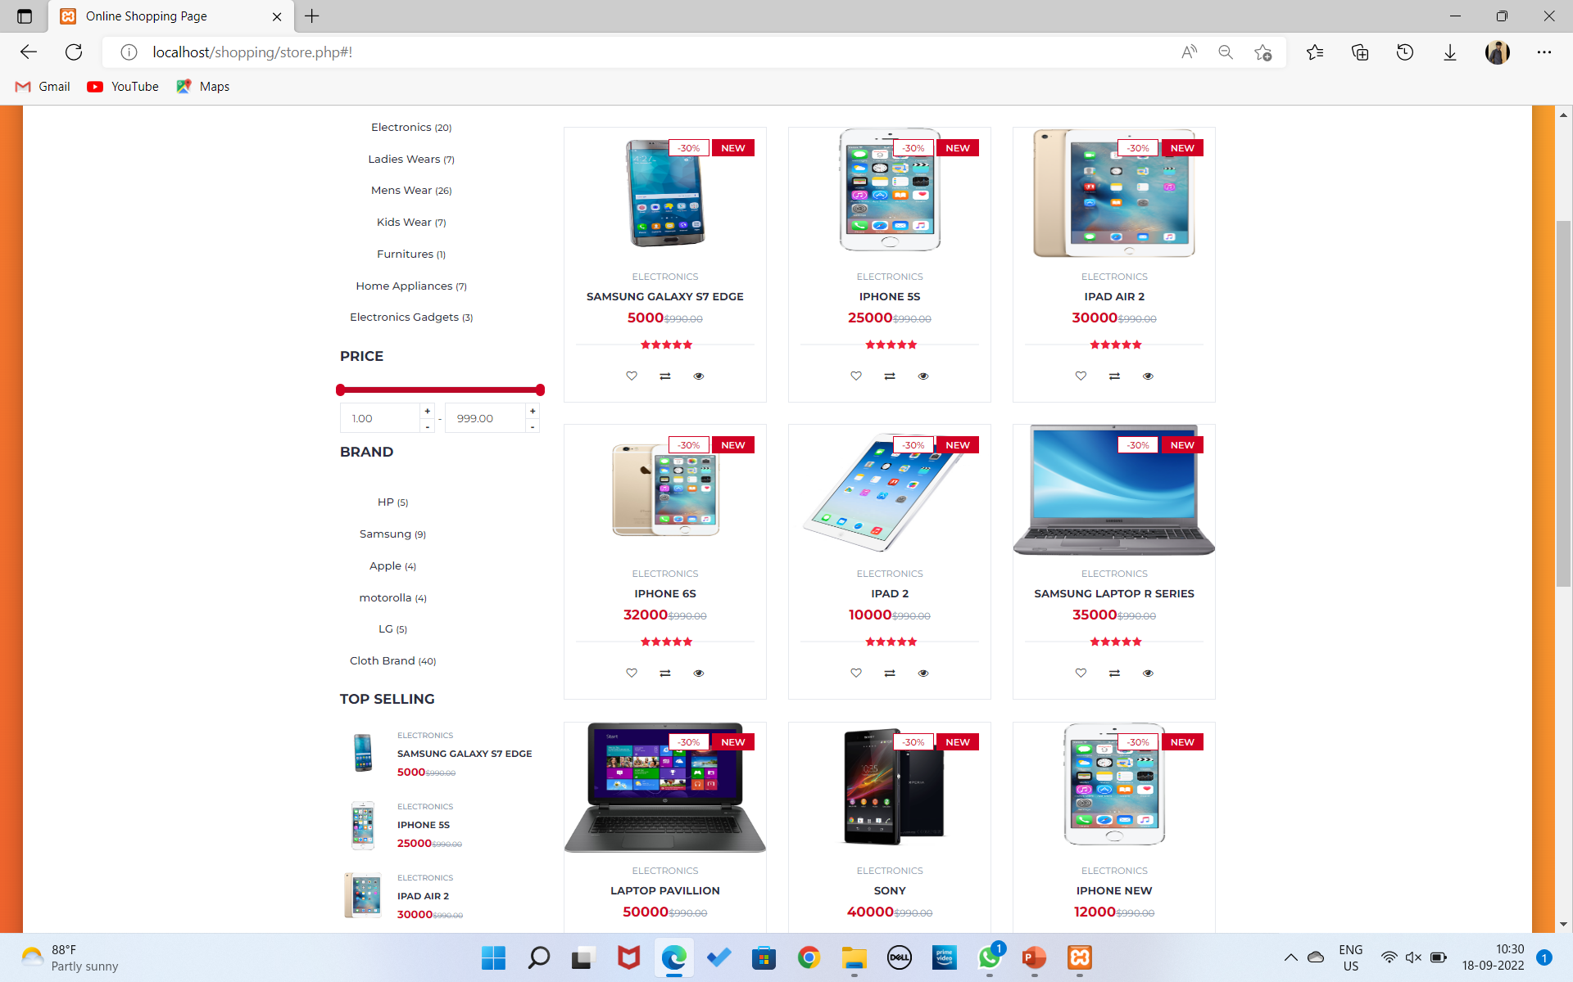
Products:-

Slide 22
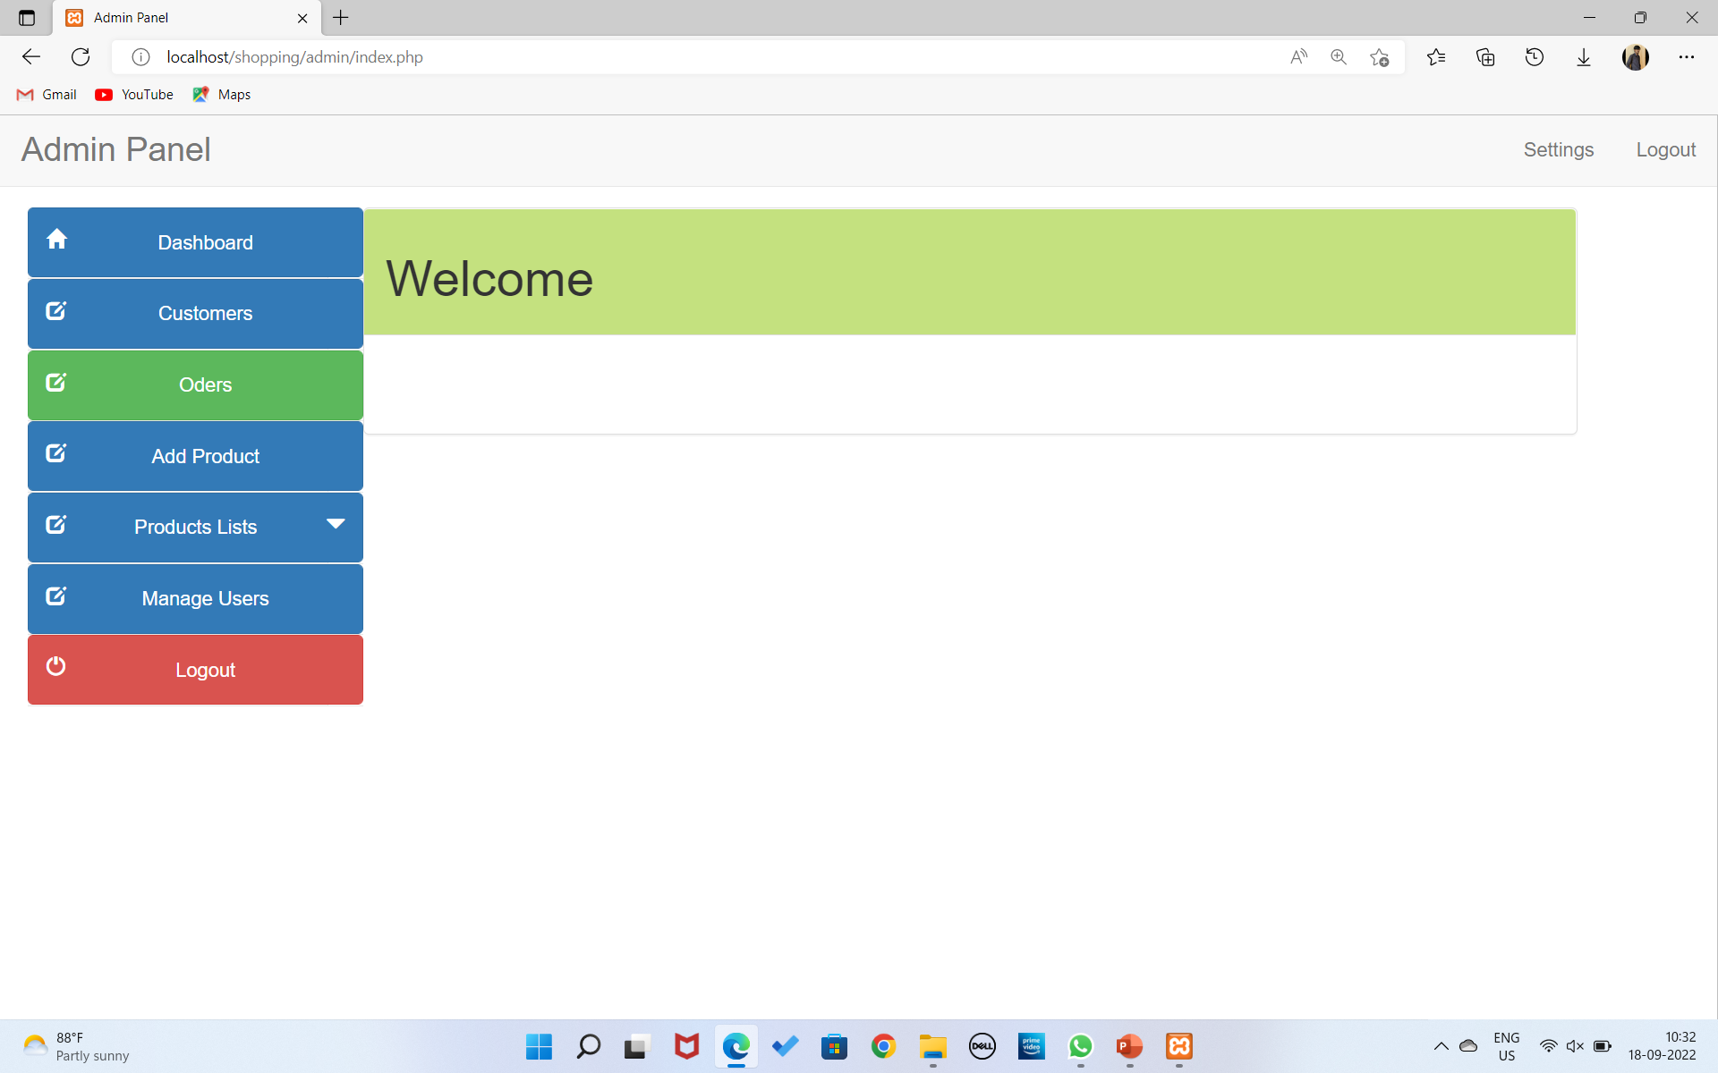
Admin Panel:-

Slide 23
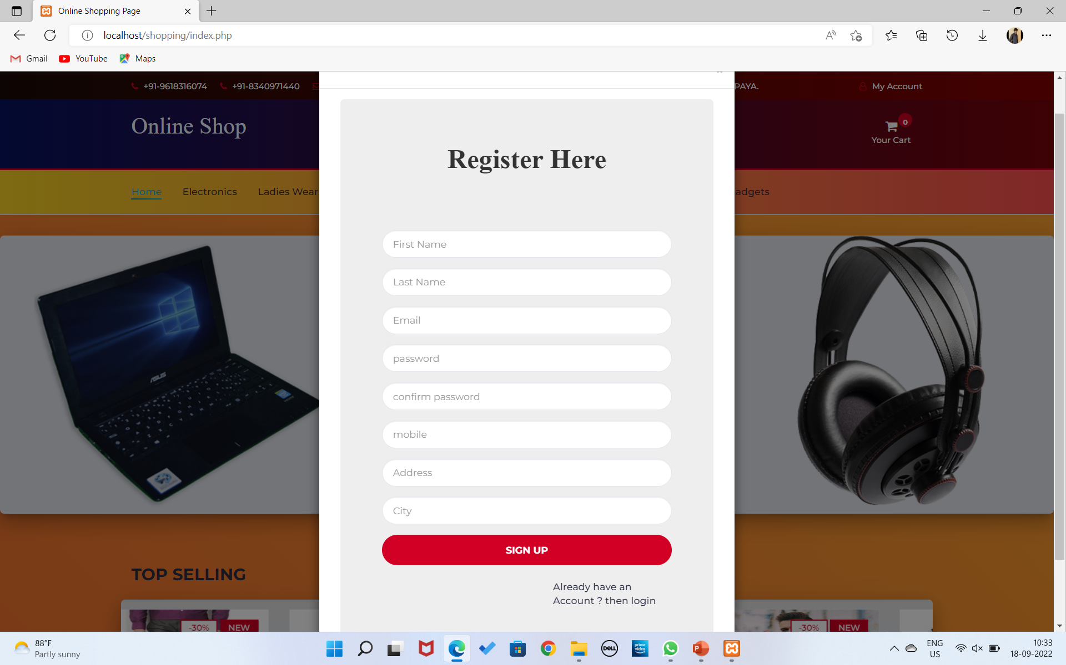
User Registration:

Slide 24
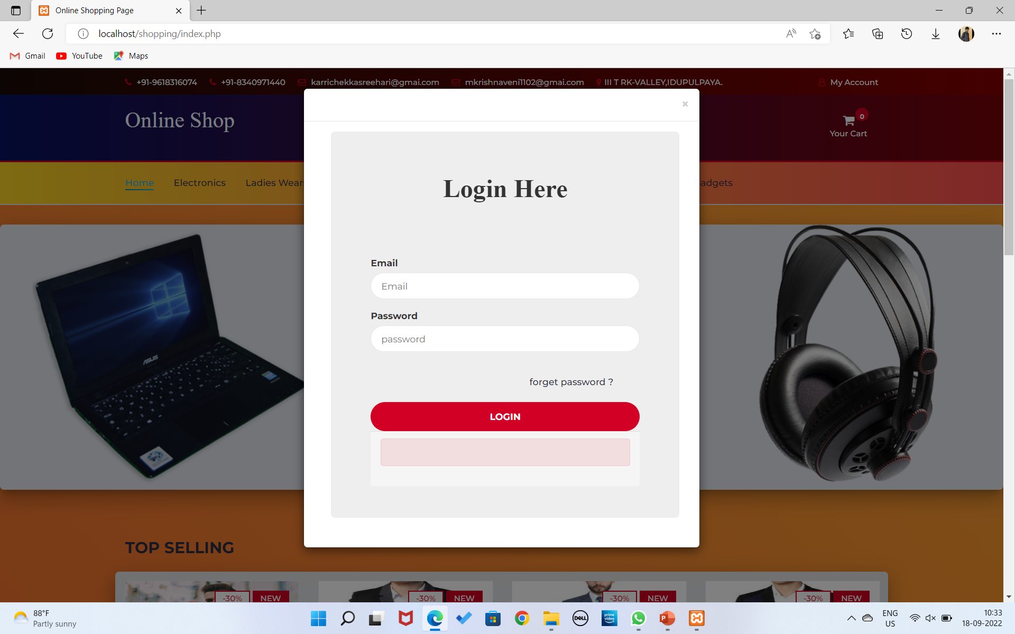
Admin/User Login:

Slide 25
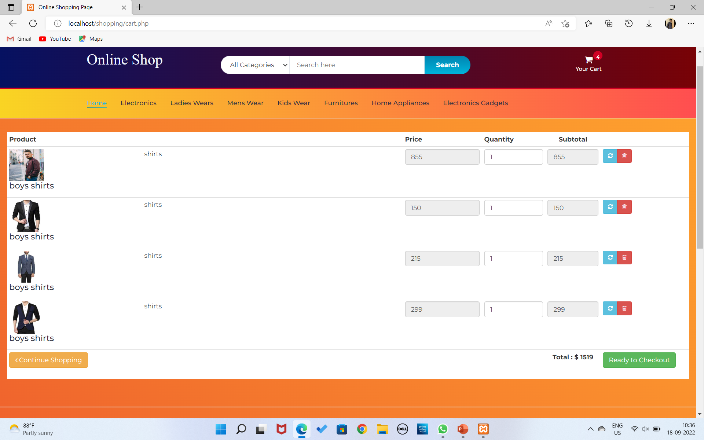
Cart:-

Slide 26
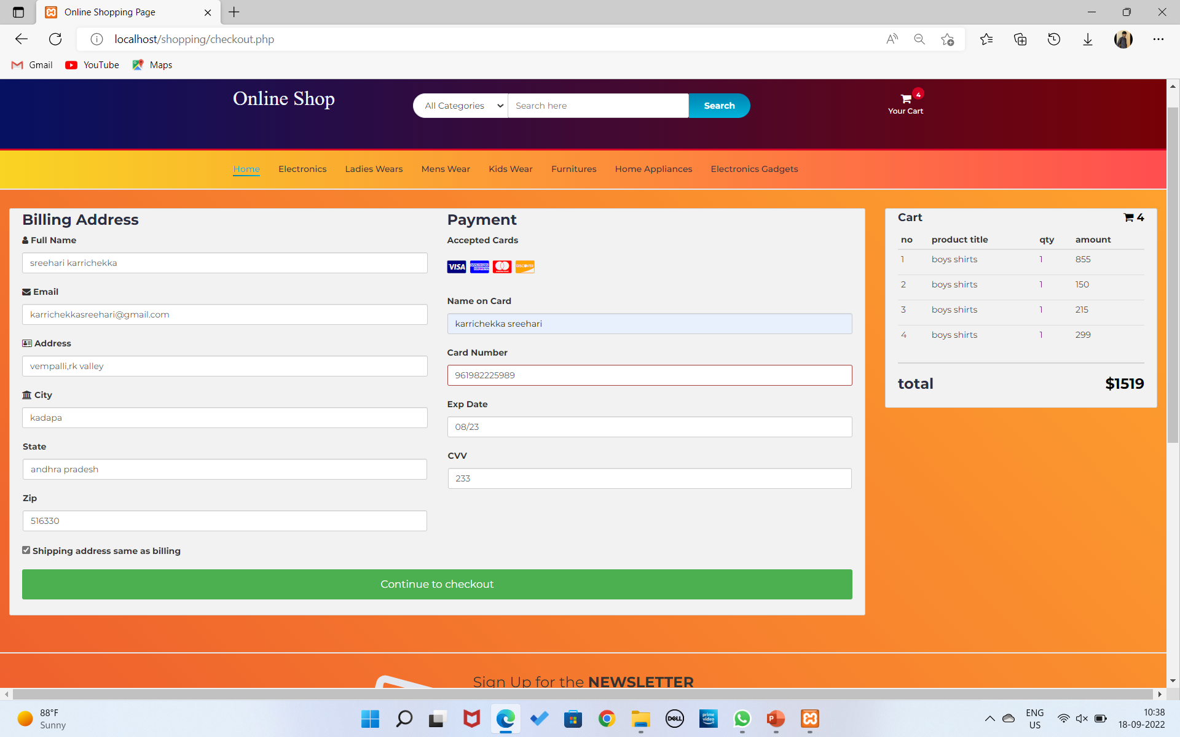
Checkout:-

Slide 27
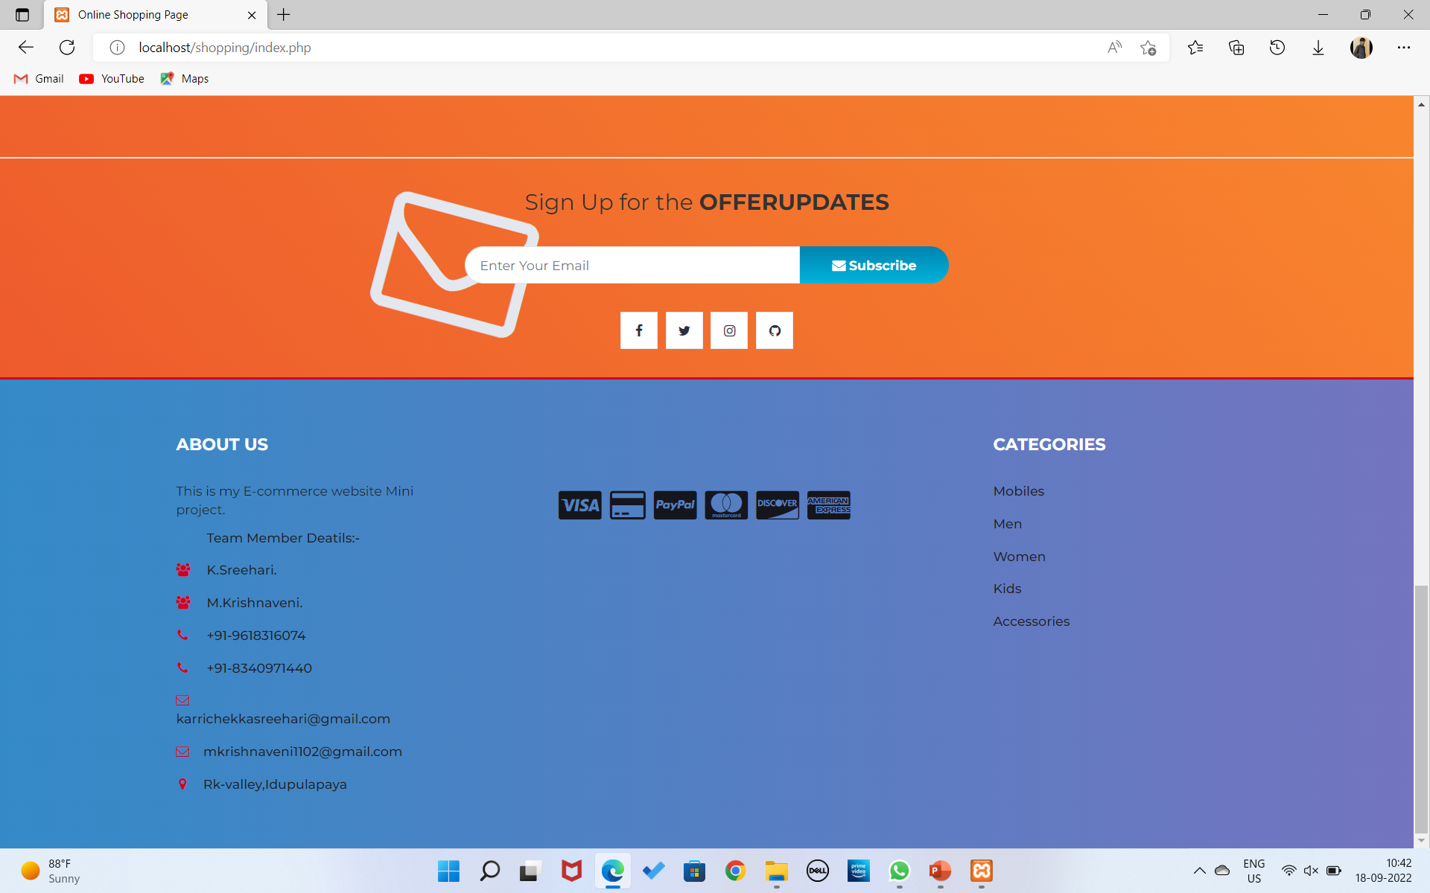
Footer:-

Slide 28
Requirements
Software Requirements:-
OS:- Windows 8,9,10,11
Database: Mysql.
Technologies: HTML , CSS , JavaScript , Boot Strap , J-Query , PHP , MYSQL.
Server: XAMP Server.
Hardware Requirements:-
I3 – Processor
2GB-Ram.
250Gb Hard Disk.

Slide 29
Conclusion
After careful oberservation, it has come to my conclusion that e-commerce has undeniably become an important part of our society. The world wide web is and will have a large part in our daily lives. It is therefore critical that small businesses have their own to keep in competition with the larger websites.
These business transactions occur either as business-to-business (B2B), business-to-consumer (B2C), consumer-to-consumer or consumer-to-business.

Slide 30
Future Enhancement
The Content Goes here.

Slide 31
References
HTML & CSS:-
HTML – GeeksforGeeks
CSS – GeeksforGeeks
PHP:
https://www.php.net
PHP Tutorials – GeeksforGeeks
MySql.
https://www.mysql.com
MySQL | Common MySQL Queries - GeeksforGeeks
BootStrap:-
https://getbootstrap.com
Bootstrap – GeeksforGeeks
J-Query:-
https://jquery.com
jQuery – GeeksforGeeks

Slide 32


